Slide 1


Lesson 1: Introducing Windows Server 2016
MOAC 70-740: Installation, Storage and Compute with Windows Server 2016

Slide 2
Overview
No actual objectives are covered in this lesson. This lesson is provided as supplementary information in an effort to prepare you for the information you will learn in subsequent chapters.
Notes:
Lecture notes go here

Slide 3
Introducing Windows Server 2016
The newest client operating system released by Microsoft is Windows 10.
Windows 7 is paired with Windows Server 2008 R2, Windows 8 is paired with Windows Server 2012, and Windows 8.1 is paired with Windows Server 2012 R2. However, Microsoft released Microsoft Server 2016 almost a year after the release of Windows 10.

Slide 4
Introducing Windows Server 2016
Windows Server 2016 provides several network services. Some of the more common services include:
Active Directory Certificate Services: Allows you to create certification authorities and related servers that enable you to issue and manage digital certificates.
Active Directory Domain Services: Stores information about objects on the network on domain controllers. Users will then use the domain controllers to authenticate, which can be used to check resource access authorization.

Slide 5
Introducing Windows Server 2016
Active Directory Federation Services: Provides simplified, secured identity federation and web Single Sign-On (SSO) capabilities.
DHCP Server: Allows you to centrally configure, manage, and provide temporary IP addresses and related information for client computers.
DNS Server: Provides name resolution for TCP/IP networks.
File and Storage Services: Enables you to provide files over the network.
Hyper-V: Provides the services that you can use to create and manage virtual machines and their resources.

Slide 6
Introducing Windows Server 2016
Print and Document Services: Enables you to centralize print server and network printer management tasks.
Remote Access: Provides connectivity via DirectAccess, VPN, and Web Application Proxy.
Remote Desktop Services: Enables users to access virtual desktops, session-based desktops, and RemoteApp programs.
Web Server/Internet Information Services (IIS): Provides a reliable, manageable, and scalable Web Application infrastructure.

Slide 7
Introducing Windows Server 2016
Windows Deployment Services: Provides a simplified, secure means of rapidly and remotely deploying Windows operating systems to computers over the network.
Windows Server Update Services: Allows network administrators to specify the Microsoft updates that should be installed and to create separate groups of computers for different sets of updates.

Slide 8
Configuring Windows Server 2016
Windows Server 2016 is a robust and flexible system that works on and supports a wide range of hardware.
Although it was designed for larger computers, it can work on laptops and desktop computers.
It can also be executed as a virtual machine.
Windows Server 2016 contains a GUI, so the primary tools to configure Windows are Settings and Control Panel (which also are graphical tools).

Slide 9
Configuring & Customizing the Start Menu, Desktop, Taskbar, and Notification Settings
The desktop is the main screen that you see when you first start the computer and log on to Windows.
Like the top of an actual desktop, it is where you perform your work by opening and running one or more applications.
It also includes the Recycle Bin, which is used to recover files that have been previously deleted.

Slide 10
Configuring & Customizing the Start Menu, Desktop, Taskbar, and Notification Settings
At the bottom of the desktop is the taskbar, which shows you the programs that are running and allows you to navigate between those programs.
On the taskbar, the Start button is shown at the lower-left corner.
When you click the Start button, the Start menu opens (see next slide).
The Start menu is a blend of the Windows 7 Start menu and the Windows 8 Start screen.

Slide 11
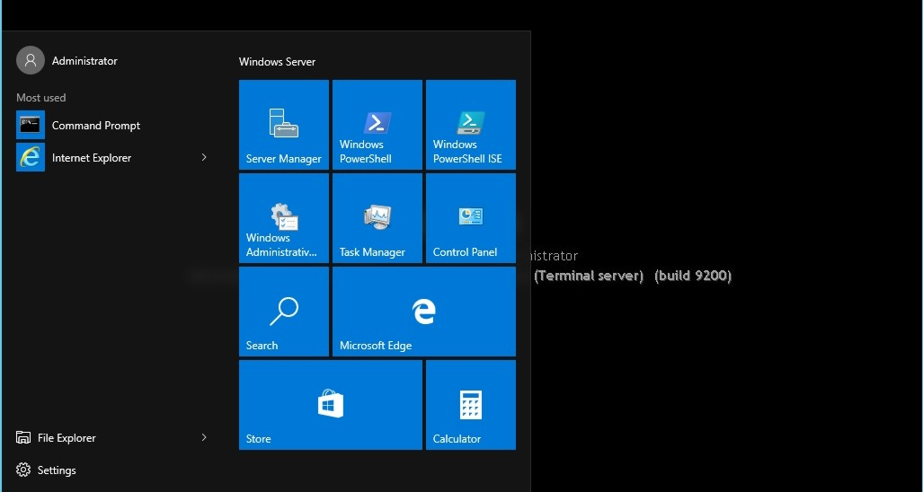
Configuring & Customizing the Start Menu, Desktop, Taskbar, and Notification Settings
Notes:
Viewing the Windows Server 2016 desktop with the Start menu open

Slide 12
Using Windows Server 2016 Settings
The Windows Server 2016 Settings is a modern interface for common configuration settings that would have been found in Control Panel on older versions of Windows.
You will also find additional settings such as touch screen, tablet, and privacy settings that are geared toward phones and tablets that you will not find in Control Panel.
Open settings by clicking the Start button and then clicking Settings, which opens the Settings page (see the next slide).

Slide 13
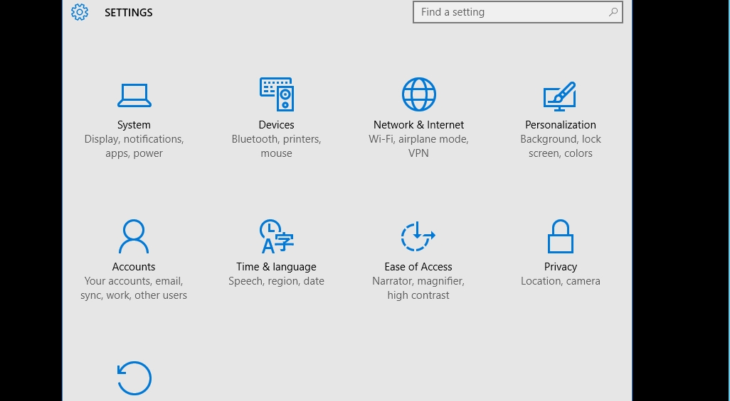
Using Windows Server 2016 Settings
Notes:
Accessing Windows Server 2016 Settings

Slide 14
Using Windows Server 2016 Settings
These settings are organized as follows:
System: Allows you to configure the display, notifications & actions, apps and features, multitasking, tablet mode, power & sleep options, and default apps
Devices: Provides quick access to hardware devices, such as printers, which you can use with the currently selected app
Network & Internet: Keeps track of Wi-Fi connections and allows you to configure VPN, dial-up connections, Ethernet connections, and proxy settings
Personalization: Provides settings for the background, colors, lock screen, themes, and Start menu
Accounts: Allows you to change the profile picture and add accounts

Slide 15
Using Windows Server 2016 Settings
Time & language: Allows you to configure Date & time, Region & language, and Speech
Ease of Access: Provides settings for Narrator, Magnifier, high contrast, closed captions, keyboard, and mouse settings
Privacy: Allows you to configure camera, microphone, speech, account information, contacts, calendar, messaging, and application radios control for Wi-Fi/Bluetooth connection
Update and security: Allows you to configure Windows Update, activate Windows, perform backups and recoveries, and configure Windows Defender

Slide 16
Using Control Panel
With previous versions of Windows, Control Panel was a primary graphical utility to configure the Windows environment and hardware devices.
It can be accessed in Windows Server 2016 by right-clicking the Start button and choosing Control Panel. See the next slide.

Slide 17
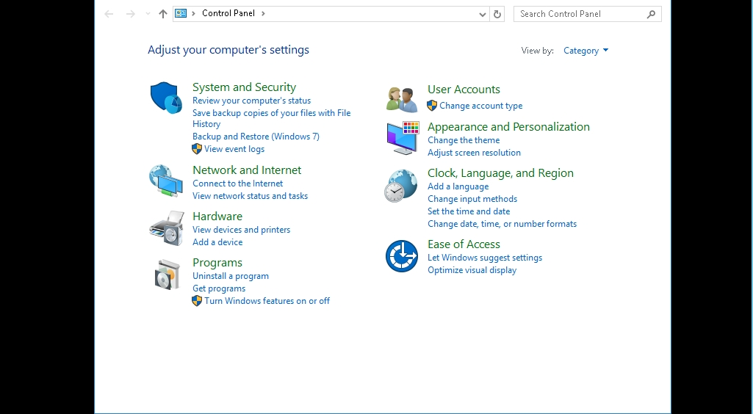
Using Control Panel

Slide 18
Add a Computer to the Domain
GET READY. To add a computer running Windows Server 2016 to the domain, perform the following steps.
On a computer that is running Windows Server 2016, log on as a local administrator.
Right-click the Start button and choose System.
When the Control Panel System page opens, in the Computer name, domain, and workgroup settings option, click the Change settings option.

Slide 19
Add a Computer to the Domain
When the System Properties dialog box opens, the Computer Name tab is already selected. Click the Change button.
When the Computer Name/Domain Changes dialog box opens, select the Domain option. Then type in the name of the domain, such as Adatum.com, and click OK.
When the Windows Security dialog box opens, log on as administrator with the password of Pa$$w0rd, and click OK.
When you receive a welcome to the domain message, click OK.

Slide 20
Add a Computer to the Domain
When you are prompted to restart your computer to apply these changes, click OK.
Back at the System Properties dialog box, click Close.
When you are prompted to restart your computer to apply these changes, click Restart Now.

Slide 21
Install the Remote Assistance Feature
GET READY. To install the Remote Assistance feature, perform the following steps.
Open Server Manager.
At the top of the Server Manager console, click Manage > Add Roles and Features. The Add Roles and Feature Wizard opens.
On the Before You Begin page, click Next.
Select Role-based or feature-based installation and then click Next.

Slide 22
Install the Remote Assistance Feature
On the Select Destination Server page, select the server that you are installing to and click Next.
On the Select Server Roles page, click Next.
On the Select Features page, select the Remote Assistance feature and click Next.
On the Confirm Installation Selections page, click Install.
When the installation is complete, click Close.

Slide 23
Using Server Manager
When managing Windows Server 2016, one of the primary tools you will use is Server Manager, which is used to install, configure, and manage Windows Server 2016 server roles and features.
It can also be used to manage local and remote servers without using the Remote Desktop Protocol connections.

Slide 24
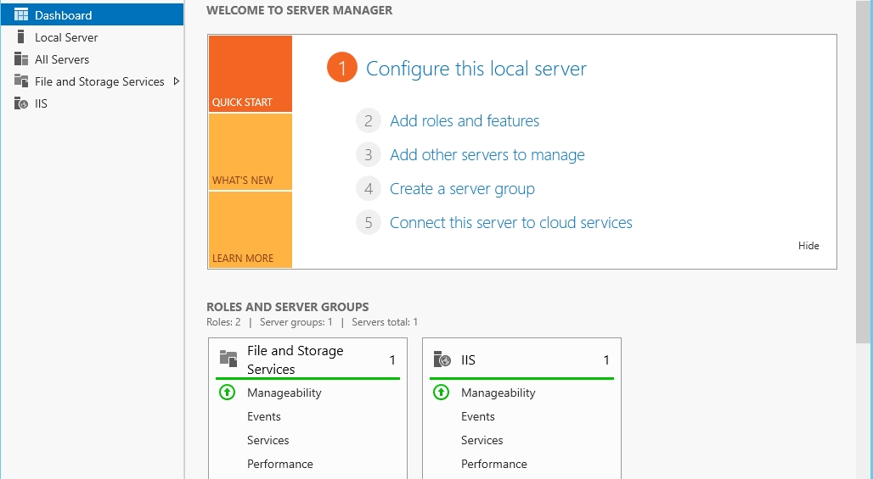
Using Server Manager
Notes:
Accessing Server Manager

Slide 25
Using Server Manager
Server Manager provides a single tool so that you can perform the following:
View, add, remove, and modify server roles and features installed on the server.
Perform common local server management tasks, such as enabling or disabling Windows Firewall, Remote management, Remote Desktop, NIC teaming, Windows Defender, and IE Enhanced Security Configuration.
It can also configure Windows updates and the computer time zone.

Slide 26
Using Server Manager
Perform management tasks associated with the installed server role.
Determine server and server role status, identify critical events, and analyze and troubleshoot configuration issues or failures.
Access Best Practices Analyzer, which is used to reduce best practice violations for specific server roles.
By default, Server Manager is pinned to the Start menu.

Slide 27
Using Computer Management
Windows includes an Administrative Tools folder that consists of multiple tools that will be used to configure Windows Server 2016.
One of the more useful tools when managing a computer running Windows Server 2016 is the Computer Management console, which allows you to view events, configure disks, manage users and groups, and manage shared folders.

Slide 28
Using Computer Management
The Microsoft Management Console (MMC) is one of the primary administrative tools used to manage Windows and many of the network services provided by Windows.
It provides a standard method to create, save, and open the various administrative tools provided by Windows.
When you open Administrative Tools, most of these programs are MMCs.

Slide 29
Using Computer Management
Administrative Tools is a folder in Control Panel that contains tools for system administrators and advanced users. You can access it 4 ways:
Open Control Panel and then click Start > Control Panel > System and Security > Administrative Tools while in Category view.
Double-click the Administrative Tools applet while in Icon view.
Click the Start button > Windows Administrative Tools.
Open the Tools menu in Server Manager.

Slide 30
Using Computer Management
Administrative Tools is a folder in Control Panel that contains tools for system administrators and advanced users. You can access it 4 ways:
Open Control Panel and then click Start > Control Panel > System and Security > Administrative Tools while in Category view.
Double-click the Administrative Tools applet while in Icon view.
Click the Start button > Windows Administrative Tools.
Open the Tools menu in Server Manager.

Slide 31
Using Computer Management
Some common administrative tools in this folder include:
Component Services: Configures and administers Component Object Model (COM) components. Component Services is designed for use by developers and administrators.
Computer Management: Manages local or remote computers by using a single, consolidated desktop tool. Using Computer Management, you can perform many tasks, such as monitoring system events, configuring hard disks, managing system performance, managing users and groups, and managing shared folders. It includes other administrative tools, including Event Viewer, Task Scheduler, Performance Monitor, Services, Disk Management, and Device Manager.

Slide 32
Using Computer Management
Defragment and Optimize Drives: Optimizes drives by rearranging files of a specific hard drive in a contiguous order.
Disk Cleanup: Frees up space on a hard disk by removing temporary files and unneeded Windows Update files.
Event Viewer: Views information about significant events, such as programs starting or stopping or security errors that are recorded in event logs.
iSCSI Initiator: Configures advanced connections between storage devices on a network.

Slide 33
Using Computer Management
Local Security Policy: Views and edits Group Policy security settings.
ODBC Data Sources (32-bit and 64-bit): Uses Open Database Connectivity (ODBC) to move data from one type of database (a data source) to another.
Performance Monitor: Views advanced system information about the processor, memory, hard disk, and network performance.
Print Management: Manages printers and print servers on a network and performs other administrative tasks.
Resource Monitor: Displays information about the usage of hardware (CPU, memory, disk, and network) and software (file handles and modules) in real time.

Slide 34
Using Computer Management
Server Manager: Allows you to install, configure, and manage Windows Server 2016 server roles and features.
Services: Manages the different services that run in the background on your computer.
System Configuration: Identifies problems that might be preventing Windows from running correctly.
System Information: Shows details about your computer’s hardware configuration, computer components, and software, including drivers.
Task Scheduler: Schedules programs or other tasks to run automatically.

Slide 35
Using Computer Management
Windows Firewall with Advanced Security: Manages the host-based firewall, including enabling/disabling Windows Firewall and creating exceptions.
Windows Memory Diagnostic: Checks your computer’s memory to see whether it is functioning properly.
Windows PowerShell: Provides a task-based command-line shell and scripting language designed especially for system administration.

Slide 36
Create a Local Account Using Computer Management
GET READY. To create a Windows Server 2016 local account using Computer Management, perform the following steps.
On LON-SVR1, right-click the Start button and choose Computer Management.
When the Computer Management console opens, expand Local Users and Groups and click Users, as shown on the next slide.

Slide 37
Create a Local Account Using Computer Management
Notes:
Managing users with Computer Management

Slide 38
Create a Local Account Using Computer Management
Right-click the Users node and choose New User.
In the User name text box, type a name such as User2. In the Full name text box, type User 2.
In the Password and Confirm password text boxes, type a password such as Pa$$w0rd.
Click the Create button.
Close the New User dialog box by clicking Close.

Slide 39
Add a User Account to the Administrator Account
GET READY. To create a Windows 10 local account using Computer Management, perform the following steps.
On LON-SVR1, right-click the Start button and choose Computer Management.
In the Computer Management console, expand Local Users and Groups and then click Groups.
Double-click the Administrators group.
In the Administrators Properties dialog box, click Add.

Slide 40
Add a User Account to the Administrator Account
If the computer is not part of a domain, the location will be set to the local computer. If the computer is part of a domain, the location will be set to the domain. If you need to change the domain to a local computer so that you can add a local user account, click the Locations button to open the Locations dialog box. Then select the domain (such as Adatum.com), and click OK.
In the Select Users dialog box, in the Enter the object names to select text box, type the name of the user that you want to add, such as user2, and click OK.

Slide 41
Networking with Windows Server 2016
Internet Protocol (IP) is the key protocol in the TCP/IP suite. It is responsible for adding addressing information to the packets for the sender and the receiver, as well as adding data to help route and deliver the packet.
Windows Server 2016 uses TCP/IP as its default networking protocol.

Slide 42
Networking with Windows Server 2016
Transmission Control Protocol/Internet Protocol (TCP/IP) is a set of protocols that allows computers to exchange data within a network and between networks.
These protocols (or rules) manage the content, format, timing, sequencing, and error control of the messages that are exchanged between the devices.

Slide 43
Networking with Windows Server 2016
Every device that communicates over TCP/IP must have a unique IP address.
Windows Server 2016 uses a dual-layer architecture that enables it to implement both IPv4 and IPv6 address schemes. Both share the common TCP Transport layer protocol.

Slide 44
Exploring IPv4 and IPv6 Protocols
An IPv4 address is a 32-bit-long number assigned to a host on the network.
These addresses are organized into four sections called octets, which are 8 bits long. For example, the number 192.160.10.2 in binary is 11000000.10100000.00001010.00000010
A portion of the 32 bits is associated with the network on which the computer is physically located. This portion of bits is called the network ID.
The remaining bits, allocated to the host, are called the host ID.

Slide 45
Networking with Windows Server 2016
IPv6 provides a number of benefits for TCP/IP-based networking connectivity, including:
A 128-bit address space to provide addressing for every device on the Internet with a globally unique address
More efficient routing than IPv4
Support for automatic configuration
Enhanced security to protect against address and port scanning attacks and utilization of IPsec to protect IPv6 traffic

Slide 46
Using the Default Gateway
A default gateway is a device, usually a router, which connects the local network to other networks.
When you need to communicate with a host on another subnet, you forward all packets to the default gateway.

Slide 47
Understanding Name Resolution
Name resolution is the process of associating host names to IP addresses.
The Windows operating system supports multiple name resolution systems. The most common is the Domain Name System (DNS).
DNS, a naming service used by the TCP/IP network, is an essential service used by the Internet.
DNS can be integrated with other services, such as WINS, DHCP, and Active Directory.
DNS servers are used to associate a computer name to an IP address.

Slide 48
Configuring IP Settings and Name Resolution Settings
Network settings can be configured either manually or automatically using DHCP.
Using manual settings can introduce configuration issues that could affect communications. Using a centralized approach to IP address management requires you to have a solid understanding of DHCP.
The Network and Sharing Center (see the next slide) is the primary tool that can view, create, and modify local area network (LAN), wireless local area network (WLAN), virtual private network (VPN), dial-up, and Broadband connections.

Slide 49
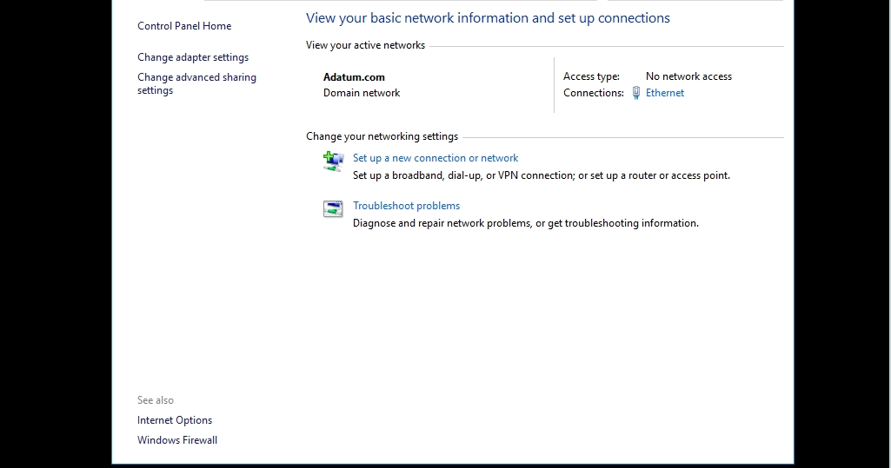
Configuring IP Settings and Name Resolution Settings
Notes:
Using the Network and Sharing Center

Slide 50
Define a Static IPv4 Address
GET READY. To define a static IPv4 address, perform the following steps.
On LON-SVR1, on the taskbar, right-click the network status icon and choose Open Network and Sharing Center.
Click Change adapter settings.
Right-click a network adapter, such as Ethernet, and choose Properties.

Slide 51
Define a Static IPv4 Address
In the Ethernet Properties dialog box, click Internet Protocol Version 4 (TCP/IPv4) and then click Properties.
Select Use the following IP address and then type the IPv4 address, subnet mask, and default gateway you want to use.
Select Use the following DNS server addresses and then type an IP address for a preferred DNS server and an alternate DNS server.

Slide 52
Define a Static IPv4 Address
Click OK to accept your settings and to close the Internet Protocol Version 4 (TCP/IPv4) Properties dialog box.
Click Close to close the Ethernet Properties dialog box.

Slide 53
Define a Static IPv6 Address
GET READY. To define a static IPv6 address, perform the following steps.
On the taskbar, right-click the network status icon and choose Open Network and Sharing Center.
Click Change adapter settings.
Right-click a network adapter, such as Ethernet, and choose Properties.
In the Ethernet Properties dialog box, click Internet Protocol Version 6 (TCP/IPv6) and then click Properties.

Slide 54
Define a Static IPv6 Address
Select Use the following IPv6 address and then type the IPv6 address, subnet prefix length, and default gateway you want to use.
Select Use the following DNS server addresses and then type an IP address for a preferred DNS server and an alternate DNS server.
Click OK to accept your settings and to close the Internet Protocol Version 6 (TCP/IPv6) Properties dialog box.
Click Close to close the Ethernet Properties dialog box.

Slide 55
Introducing Windows PowerShell
Windows PowerShell is a command-line interface used mainly by IT professionals to run cmdlets (pronounced command-lets), complete background jobs (processes or programs that run in the background without a user interface), and run scripts to perform administrative tasks.
Component Object Model (COM) provides a platform-independent, distributed, object-oriented system for creating software components.

Slide 56
Introducing Windows PowerShell
Windows Management Instrumentation (WMI) is the Microsoft implementation of Web-Based Enterprise Management (WBEM) that allows accessing management information in an enterprise environment.
WMI uses the Common Information Model (CIM) industry standard to represent systems, applications, networks, devices, and other managed components.

Slide 57
Introducing Windows PowerShell
Cmdlets (pronounced command-lets) are native commands available in Windows PowerShell. They follow a verb-noun naming pattern, such as get-process, get-service, get-help, set-date, or stop-process. Common verbs include:
Add: Add a resource to a container, or attach an item to another item.
Get: Retrieve data from a resource.
New: Create a new resource.
Remove: Delete a resource from a container.
Set: Modify a resource, such as data or system parameters.
Start: Begin an operation, such as a process or a program.

Slide 58
Run a Cmdlet in Windows PowerShell
GET READY. To run a cmdlet in Windows PowerShell, perform the following steps.
Click the Start button and type PowerShell. From the results, click Windows PowerShell.
A commonly used command is ps (or get-process). The ps command lists the currently running processes and their details, such as the process ID, process name, and percentage of processor usage (CPU). Type ps and press Enter.

Slide 59
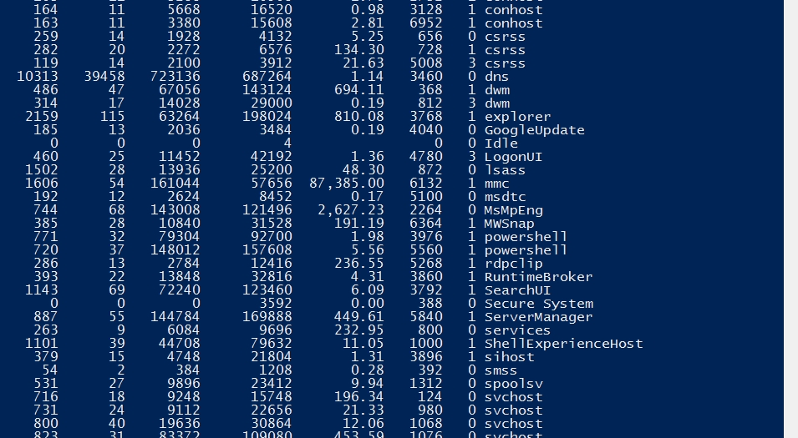
Run a Cmdlet in Windows PowerShell
Notes:
Running the ps command in Windows PowerShell

Slide 60
Run a Cmdlet in Windows PowerShell
To get help with the ps command, type get-help ps and press Enter.
To view running services, type get-service and then press Enter. A list of services displays along with their status (Running or Stopped).
To exit the Window PowerShell window, type exit and then press Enter.

Slide 61
Lesson Summary
The desktop is the main screen that you see when you first start the computer and log on to Windows.
The Windows Server 2016 Settings is a modern interface for common configuration settings that would have been found in Control Panel on older versions of Windows.
When managing Windows Server 2016, one of the primary tools you will use is Server Manager, which is used to install, configure, and manage Windows Server 2016 server roles and features. It can also be used to manage local and remote servers without using the Remote Desktop Protocol connections.

Slide 62
Lesson Summary
Windows includes an Administrative Tools folder that consists of multiple tools that will be used to configure Windows Server 2016.
One of the more useful tools when managing a computer running Windows Server 2016 is the Computer Management console, which allows you to view events, configure disks, manage users and groups, and manage shared folders.
Available public IPv4 addresses are running low. To overcome this problem as well as a few others, IPv6 was developed as the next-generation Internet Protocol version.

Slide 63
Lesson Summary
Name resolution is the process of associating host names to IP addresses. The Windows operating system supports multiple name resolution systems. The most common is the Domain Name System (DNS).
Windows PowerShell is a command-line interface used mainly by IT professionals to run cmdlets (pronounced command-lets), complete background jobs (processes or programs that run in the background without a user interface), and run scripts to perform administrative tasks.

Slide 64
Copyright 2017 John Wiley & Sons, Inc.
All rights reserved. Reproduction or translation of this work beyond that named in Section 117 of the 1976 United States Copyright Act without the express written consent of the copyright owner is unlawful. Requests for further information should be addressed to the Permissions Department, John Wiley & Sons, Inc. The purchaser may make back-up copies for his/her own use only and not for distribution or resale. The Publisher assumes no responsibility for errors, omissions, or damages, caused by the use of these programs or from the use of the information contained herein.

